Slide 1
January 2025 Kick-off
Strategic Planning
2025-2030

Slide 2
STRATEGIC PLANNING is a comprehensive process that aims to guide the institution's direction and priorities. Specific focus is given to addressing the unique challenges and opportunities of the region while aligning with broader state and national higher education goals.

Slide 3
Key Components of a Strategic Plan include:
Student Access and Success | Developing initiatives to increase enrollment, retention, and graduation rates among rural students. This may involve creating outreach programs, providing financial support, and partnering with local school districts to improve college readiness.
Workforce Development | Aligning academic programs with regional workforce needs to ensure students are prepared for local job opportunities. This could include expanding vocational and technical programs relevant to the rural South Texas economy.
Community Partnerships | Fostering collaborations with local businesses, industries, and community organizations to enhance educational opportunities and economic development in the region.
Technology and Infrastructure | Investing in digital resources and infrastructure to support online and hybrid learning options, which can be particularly beneficial for rural students
Financial Sustainability | Developing plans for efficient resource allocation and exploring alternative funding sources to ensure long-term financial stability.
Academic Excellence | Enhancing the quality and relevance of academic programs, potentially including the expansion of dual credit opportunities.
Student Support Services | Strengthening academic advising, career counseling, and other support services tailored to the needs of rural students
Key Components of a Strategic Plan include:

Slide 4
The process typically involves:
Environmental scanning to assess current trends and challenges in higher education and the local community.
Engaging stakeholders, including students, faculty, staff, and community members, for input and feedback.
Reviewing and potentially revising the college's mission, vision, and values.
Setting specific, measurable goals and objectives aligned with the identified priorities.
Developing implementation strategies and action plans for each goal.
Establishing metrics and assessment methods to track progress and ensure accountability.
The Process typically involves:
Typically includes:
Timeline: Key milestones, benchmarks, targets, and thresholds.
Metrics: Success monitoring
Accountability: Roles and Responsibilities
Next Steps and Call to Action: Immediate actions to begin implementation

Slide 5
Steering Committee 2025
Faculty Senate | Student Success & Engagement | Faculty/Pleasanton | Community Member
Faculty Senate | CE & Workforce Development | QEP Cougar Care | Community Member
NAH Faculty | Marketing | Financial Aid | Community Member
Faculty Senate | Foundation | Admissions | Student Member
IT Services & IER | CTE Faculty | TRiO Programs | Student Member
Business Services | TGE Faculty | Board of Trustees | Student Member
Residence Life | Custodial | Board of Trustees
Athletics | Pleasanton | Maintenance
Presenters will include President, Cabinet, Deans, and Directors. All will serve the steering committee as ex-officio.

Slide 6
CBC Steering Committee Planning 2024-2025
MONTH | ACTIVITY | DELIVERABLE(S)
NOVEMBER | Steering Committee Team is formed Steering Committee Planning Schedule | Steering Committee Team Planning Schedule
JANUARY | Welcome & Overview
FEBRUARY | Resources & Financial Outlook | Data Presentations External Location Visits
MARCH | Instruction & Industry
APRIL | Student Success & Engagement
MAY | Partnerships & Outreach
MAY | Identify Assessment Metrics | DRAFT To Cabinet
JUNE | Revisions and Final Submission | DRAFT To Steering Committee
JULY |  | Final Strategic Plan to Board of Trustees for Approval
AUGUST | Graphic Design Creation
AUGUST | Final Metrics
SEPTEMBER | Publication
Current Research and Data Collection
Mission, Vision, Values Focus Group
Focus Group Interviews with select staff, faculty, community
Survey to students, faculty, staff, & Community
Access & Engagement Focus Group
Community Engagement Focus Group

Slide 7
Steering Committee Planning 2024-2025
WORK PLAN | DETAILS | DATE | Location
Welcome & Overview | Welcome & 2020-2025 Accomplishments | January | CBC - Alice
 | Purpose & Call to Action
Resources and Financial Outlook | Environmental Scan* | February | CBC - Pleasanton
 | Financial Outlook
 | Master Facilities Plan
 | Master Technology Plan
Instruction and Industry | Academic Programs Presentation | March | CBC-Online
 | Academic Program Demand Analysis*
 | Academic Plan
 | Online Programming
 | Transfer Education
Student Success & Engagement | Drive to 55* | April | CBC-Kingsville
 | Cougar Care*
 | Enrollment Management Plan
 | Enrollment Trend Analysis Report*
 | Athletics
 | Residential Housing
Partnerships and Outreach | Foundation & Alumni | May | CBC-Beeville
 | Community Partnerships
 | Industry Partnerships
 | Marketing Plan

Slide 8
MISSION
Coastal Bend College is a student centered community college committed to delivering superb educational and life enriching opportunities to its students and the communities it serves.

Slide 9
What Should a mission Statement include
Mission explains the orgs purpose—what it does and for whom
Purpose and alignment with community needs
Evolution and relevance
Impact on Students and Community
Engagement and stakeholder collaboration
Call to action

Slide 10
Examples of Fortune 500 companies
Apple: "To bring the best user experience to customers through innovative hardware, software, and services."
Amazon: "To be Earth's most customer-centric company, where customers can find and discover anything they might want to buy online, and endeavors to offer its customers the lowest possible prices."
Microsoft: "To empower every person and every organization on the planet to achieve more."
Nike: "To bring inspiration and innovation to every athlete* in the world. (*If you have a body, you are an athlete.)"
Tesla: "To accelerate the world's transition to sustainable energy."

Slide 11
Nike: "To bring inspiration and innovation to every athlete* in the world. (*If you have a body, you are an athlete.)"
Tesla: "To accelerate the world's transition to sustainable energy."

Slide 12
Vision
Coastal Bend College is a leader in providing quality education for lifelong learning by dedicating its resources to promoting a learning-centered environment that empowers its students to reach their highest potential and become responsible members of the global community.

Slide 13
What Should a Vision State include
Vision – Describes aspiration future we strive to achieve.
Aspirational Future Focus
Student Success and Community Impact
Inclusivity and Equity
Innovation and Adaptability
Alignment with Mission and Values
Stakeholder Involvement
Call to action

Slide 14
Example
Dallas College (Texas)
"To be a dynamic, inclusive, and innovative educational institution that empowers individuals, strengthens communities, and inspires excellence through transformative learning experiences."

Slide 15
Example
San Jacinto College
"San Jacinto College will advance the social and economic mobility of all members of our community. We will be known for our excellence in teaching and learning, our intentional student-centered support, and our commitment to every student. We will be the preferred workforce and economic development partner in the region and a champion for lifelong learning. San Jacinto College will inspire students to explore opportunities, define their educational and career paths, and achieve their goals and dreams."

Slide 16
Core Values
Collaboration | Communication | Diversity | Excellence
Innovation | Integrity | Leadership | Learning
 | Respect | Service

Slide 17
Core Values
Core values Articulate the principles that guide decision-making and day-today operations

Slide 18
5 C's of CBC
Civility
Communication
Community
Cooperation
Collaboration

Slide 19
Coastal Bend College benchmarks

Slide 20
Coastal Bend College benchmarks

Slide 21
Student Enrollment

Slide 22
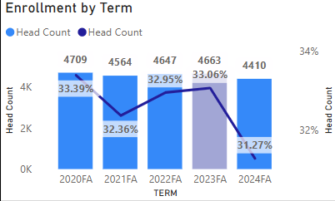
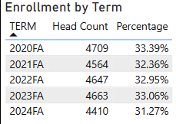
Student Enrollment: Fall Headcount
Notes:
Schedule Data Power Bi Factbook #2 Updated 10/2024 Office of Institutional Research

Slide 23
Student Enrollment: BY Location
Notes:
Schedule Data Power Bi Factbook #2 Updated 10/2024 Office of Institutional Research

Slide 24
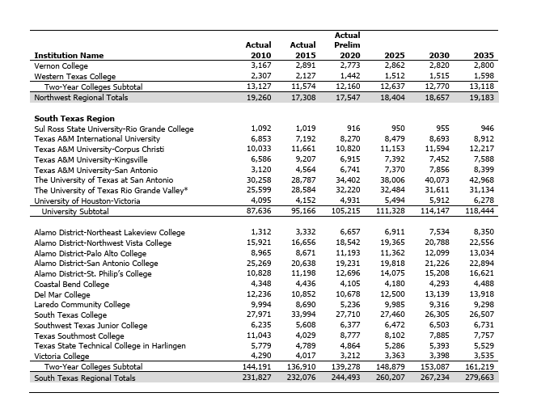
Student Enrollment Forcast
Notes:
chrome-extension://efaidnbmnnnibpcajpcglclefindmkaj/https://reportcenter.highered.texas.gov/reports/data/enrollment-forecast-2021-2035-january-2021/
60X30 THECB Enrollment Trend Report Jan 2021 Report

Slide 25
Student Population By Type

Slide 26
Student Demographics

Slide 27
Student Demographics:
Notes:
Factbook Demographics Trend Analysis Updated 01/2025
Office of Institutional Research

Slide 28
Student Retention

Slide 29
Fall to Spring

Slide 30
Fall to Fall

Slide 31
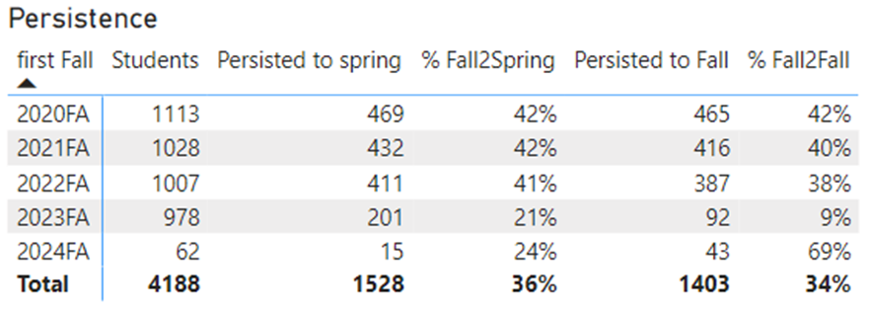
Persistence

Slide 32
Academic Success

Slide 33
Completions and Transfers
Notes:
THECB

Slide 34
Degrees/Certificates Conferred
Graduation rates of full-time, first-time degree/certificate-seeking undergraduates 150% of normal time to completion (Target Rate = 28.3%)
Year (Cohort) | Coastal Bend College | Texas Peer Group
2015 (2010 Cohort) | 11% | 18%
2016 (2011 Cohort) | 24% | 17%
2017 (2012 Cohort) | 25% | 18%
2018 (2013 Cohort) | 24% | 22%
2019 (2014 Cohort) | 24% | 22%
2020 (2015 Cohort) | 25% | 25%
2021 (2016 Cohort) | 23% | 28%
2022 (2017 Cohort) | 24% | 27%
2023 (2018 Cohort) | 27% | 26%
Source: National Center for Education Statistics, IPEDS data http://nces.ed.gov/ipeds/datacenter/institutionprofile.aspx?unitid=223320

Slide 35
Graduation Rates: 150%
Graduation rates of full-time, first-time degree/certificate-seeking undergraduates 150% of normal time to completion (Target Rate = 28.3%)
Year (Cohort) | Coastal Bend College | Texas Peer Group
2015 (2010 Cohort) | 11% | 18%
2016 (2011 Cohort) | 24% | 17%
2017 (2012 Cohort) | 25% | 18%
2018 (2013 Cohort) | 24% | 22%
2019 (2014 Cohort) | 24% | 22%
2020 (2015 Cohort) | 25% | 25%
2021 (2016 Cohort) | 23% | 28%
2022 (2017 Cohort) | 24% | 27%
2023 (2018 Cohort) | 27% | 26%
Source: National Center for Education Statistics, IPEDS data http://nces.ed.gov/ipeds/datacenter/institutionprofile.aspx?unitid=223320

Slide 36
Degrees/Certificates Conferred
2023-2024 Award Totals
Total Level I Certificates | 169
Total Level II Certificates | 44
Total Fundamentals Certificates | 56
Total Marketable Skills Certificates | 0
Total Occupational Skills Award | 69
Total AA degrees Awarded | 93
Total AS degrees Awarded | 182
Total AAS degrees Awarded | 114
Total Earned Degrees | 582

Slide 37
Degrees/Certificates Conferred

Slide 38
Remedial/Developmental Sucess

Slide 39
Student Satisfaction

Slide 40
Graduation Survey

Slide 41
Registration Survey

Slide 42
College Personnel

Slide 43
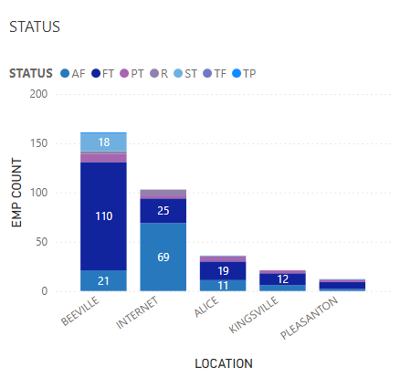
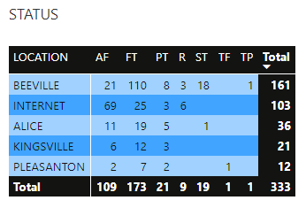
Active Employees
Notes:
Power BI HR – Active Employees

Slide 44
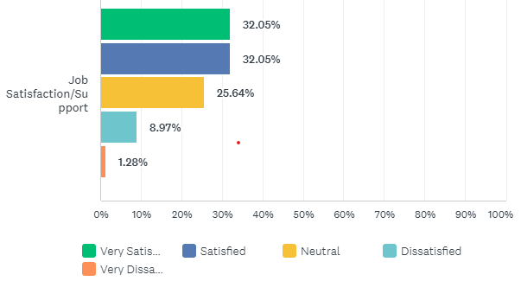
Employee Satisfaction Survey
Notes:
CCSSE 2023

Slide 45
Finacial Outlook

Slide 46
Resource Development
Core Expenses per FTE Enrollment | 2019-2020 Baseline Year | 2020-2021 | 2021-2022 | 2022-2023 | 2023-2024
FTE Enrollment | 2688 | 2720 | 2256 | 1620 | 1560
Instructional Support per FTE | $2,249 | $2,450 | $2,765 | $3,411 | $3,574
Academic Support per FTE | $169 | $178 | $521 | $663 | $545
Student services per FTE | $394 | $475 | $1,402 | $4,541 | $4830
Institutional Support per FTE | $2,376 | $1,928 | $2,768 | $4,058 | $3,947
Other Expenditures per FTE | $2,373 | $2,826 | $1,803 | $2,511 | $3,164
Total Operating Expenses per FTE | $8,213 | $8,466 | $9,259 | $15,184 | $11,231
Notes:
IPEDS Finance Survey

Slide 47
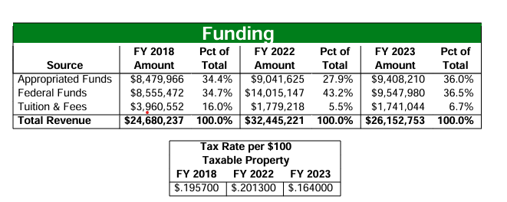
Finacial rations
Notes:
Online Resume for Legislators and Other Policymakers COASTAL BEND COLLEGE THECB

Slide 48
Tuition Comparison
Notes:
Online Resume for Legislators and Other Policymakers COASTAL BEND COLLEGE THECB

Slide 49
Accomplishments

Slide 50
Accomplishments

Slide 51
Activity 1

Slide 52
Activity 1: Who are WE?
Who are our students?
What is our Mission?

Slide 53
Activity 2

Slide 54
Activity 2: Challenges
In your respective groups, please brainstorm, discuss, and list the challenges CBC is currently facing.

Slide 55
Sources & Citations
American Association of Community Colleges. (2024). The future of community colleges: Trends and strategic priorities for 2025-2030. Washington, DC: AACC Press.
Gonzalez, M. A., & Rodriguez, L. F. (2023). Serving rural Hispanic students: Strategies for success in South Texas community colleges. Journal of Hispanic Higher Education, 22(3), 215-230.
Kuh, G. D., Kinzie, J., Schuh, J. H., & Whitt, E. J. (2022). Student success in college: Creating conditions that matter (3rd ed.).
Jossey-Bass. Martinez, E., & Johnson, D. R. (2024). Community college strategic planning: A comprehensive guide for rural institutions. New Directions for Community Colleges, 2024(185), 1-95.
Texas Higher Education Coordinating Board. (2025).60x30TX: 2025 progress report and updated goals for 2030. Austin, TX: THECB.
U.S. Department of Education. (2024). Rural education in America: Challenges and opportunities. Washington, DC: Government Printing Office.

